Slide 1
Monetary and Fiscal Policy
Chapter 5

Slide 2
In this chapter, we use the IS-LM model developed in Chapter 4 to show how monetary policy and fiscal policy work.
These are the two main macroeconomic policy tools the government can call on to try to keep the economy growing at a reasonable rate, with low inflation.
They are also the policy tools the government uses to try to shorten recessions and to prevent booms from getting out of hand.

Slide 3
Fiscal policy has its initial impact in the goods market, and monetary policy has its initial impact mainly in the assets markets.
But because the goods and assets markets are closely interconnected, both monetary and fiscal policies have effects on both the level of output and interest rates.

Slide 4
The IS curve represents equilibrium in the goods market. The LM curve represents equilibrium in the money market. The intersection of the two curves determines output and interest rates in the short run, that is, for a given price level.

Slide 5
Expansionary monetary policy moves the LM curve to the right, raising income and lowering interest rates.
Contractionary monetary policy moves the LM curve to the left, lowering income and raising interest rates.

Slide 6
Expansionary fiscal policy moves the IS curve to the right, raising both income and interest rates.
Contractionary fiscal policy moves the IS curve to the left, lowering both income and interest rates.

Slide 7
NOTES:
Fiscal policy has its initial impact in the goods market
Monetary policy has its initial impact mainly in the assets markets
Because the goods and assets markets are interconnected, both fiscal and monetary policies have effects on both the level of output and interest rates
Expansionary/contractionary monetary policy moves the LM curve to the right/left
Expansionary/contractionary fiscal policy moves the IS curve to the right/left

Slide 8
MONETARY POLICY
In Chapter 4, we showed how an increase in the quantity of money affects the economy, increasing the level of output by reducing interest rates. The CB conducts monetary policy mainly through open market operations.

Slide 9
In an open market operation, the CB buys bonds (or sometimes other assets) in exchange for money, thus increasing the stock of money, or it sells bonds in exchange for money paid by the purchasers of the bonds, thus reducing the money stock.

Slide 10
We take here the case of an open market purchase of bonds. The CB pays for the bonds it buys with money that it can create. One can usefully think of the CB as “printing” money with which to buy bonds, even though that is not strictly correct.

Slide 11
When the CB buys bonds, it reduces the quantity of bonds available in the market and thereby tends to increase their price, or lower their yield—only at a lower interest rate will the public be prepared to hold a smaller fraction of its wealth in the form of bonds and a larger fraction in the form of money.

Slide 12
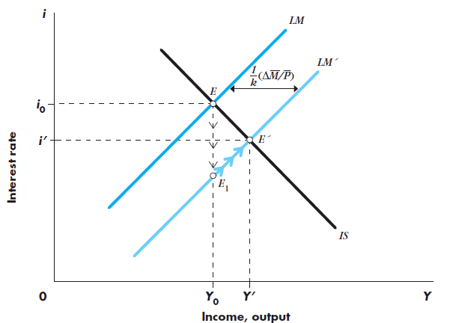
Monetary Policy
Figure 1 shows graphically how an open market purchase works. The initial equilibrium at point E is on the initial LM schedule that corresponds to a real money supply, M/P. Now consider an open market purchase by the CB. This increases the nominal quantity of money and, given the price level, the real quantity of money. As a consequence, the LM schedule will shift to LM’. The new equilibrium will be at point E’, with a lower interest rate and a higher level of income. The equilibrium level of income rises because the open market purchase reduces the interest rate and thereby increases investment spending.

Slide 13
Monetary Policy
Adjustment to the monetary expansion:
Increase in money supply creates excess supply of money
Public buys other assets
Asset prices increase, yields decrease → move to point E₁
Decline in interest rate results in excess demand for goods
Output expands and move up LM’ schedule

Slide 14
Adjustment to the monetary expansion
At the initial equilibrium point, E, the increase in the money supply creates an excess supply of money to which the public adjusts by trying to buy other assets. In the process, asset prices increase and yields decline.
Because money and asset markets adjust rapidly, we move immediately to point E1, where the money market clears and where the public is willing to hold the larger real quantity of money because the interest rate has declined sufficiently. At point E1, however, there is an excess demand for goods. The decline in the interest rate, given the initial income level has raised aggregate demand and is causing inventories to run down. In response, output expands and we start moving up the schedule.

Slide 15
Why does the interest rate rise during the adjustment process?
Because the increase in output raises the demand for money, and the greater demand for money has to be checked by higher interest rates. Thus, the increase in the money stock first causes interest rates to fall as the public adjusts its portfolio and then—as a result of the decline in interest rates—increases aggregate demand.

Slide 16
Adjustment to the monetary expansion
At E
ESM (L< M/P) → Pbond ↑ → i↓ → I ↑ → Y ↑ → L↑→ i↑ Reach to E’
At E1
EDG → Y ↑

Slide 17
Transmission Mechanism
Two steps in the transmission mechanism (the process by which changes in monetary policy affect AD):
An increase in real balances generates a portfolio disequilibrium
At the prevailing interest rate and level of income, people are holding more money than they want
Portfolio holders attempt to reduce their money holdings by buying other assets → changes asset prices and yields
The change in money supply changes interest rates
A change in interest rates affects AD

Slide 18
Table provides a summary of the stages in the transmission mechanism. There are two critical links between the change in real balances (i.e., the real money stock) and the ultimate effect on income. First, the change in real balances, by bringing about portfolio disequilibrium, must lead to a change in interest rates. Second, that change in interest rates must change aggregate demand. Through these two linkages, changes in the real money stock affect the level of output in the economy. But that outcome immediately implies the following: If portfolio imbalances do not lead to significant changes in interest rates, for whatever reason, or if spending does not respond to changes in interest rates, the link between money and output does not exist.

Slide 19
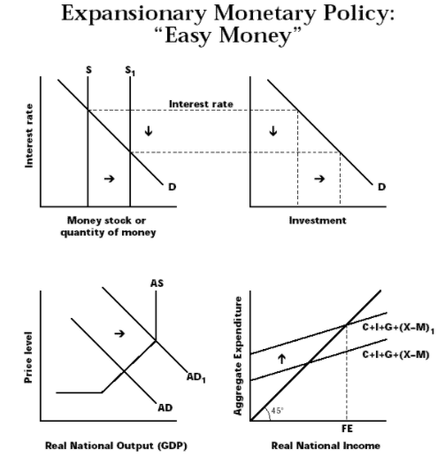

Slide 20
The Liquidity Trap
Two extreme cases arise when discussing the effects of monetary policy on the economy → first is the liquidity trap
Liquidity trap = a situation in which the public is prepared, at a given interest rate, to hold whatever amount of money is supplied
Implies the LM curve is horizontal → changes in the quantity of money do not shift it
Monetary policy has no impact on either the interest rate or the level of income → monetary policy is powerless
Possibility of a liquidity trap at low interest rates is a notion that grew out of the theories of English economist John Maynard Keynes

Slide 21
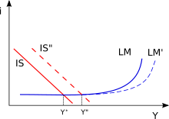
In the liquidity trap, monetary policy is powerless to affect the interest rate.
LM curve is horizontal.
h = ∞ (Money demand fully sensitive to interest-Para talebi faize tam duyarlı)

Slide 22
The Classical Case
The opposite of the horizontal LM curve (implies that monetary policy cannot affect the level of income) is the vertical LM curve
Demand for money is entirely unresponsive to the interest rate
Recall, the equation for the LM curve is (1)
If h is zero, then there is a unique level of income corresponding to a given real money supply → VERTICAL LM CURVE
The vertical LM curve is called the classical case
Rewrite equation (1), with h = 0: (2)
Implies that NGDP depends only on the quantity of money → quantity theory of money

Slide 23
If h is zero, then corresponding to a given real money supply M/P, there is a unique level of income, which implies that the LM curve is vertical at that level of income. The vertical LM curve is called the classical case.
M = k( P x Y)
M and P constant. We see that the classical case implies that nominal GDP, P x Y, depends only on the quantity of money. This is the classical quantity theory of money, which argues that the level of nominal income is determined solely by the quantity of money.

Slide 24
When the LM curve is vertical, monetary policy has a maximal effect on the level of income, and fiscal policy has no effect on income.
The vertical LM curve, implying the comparative effectiveness of monetary over fiscal policy, is sometimes associated with the view that “only money matters” for the determination of output.
Since the LM curve is vertical only when the demand for money does not depend on the interest rate, the interest sensitivity of the demand for money turns out to be an important issue in determining the effectiveness of alternative policies.

Slide 25
Fiscal Policy and Crowding Out
This section shows how changes in fiscal policy shift the IS curve, the curve that describes equilibrium in the goods market.
Recall that the IS curve slopes downward because a decrease in the interest rate increases investment spending, thereby increasing aggregate demand and the level of output at which the goods market is in equilibrium.
Recall also that changes in fiscal policy shift the IS curve. Specifically, a fiscal expansion shifts the IS curve to the right.

Slide 26
The equation for the IS curve is: (3)
The fiscal policy variables, G and t, are within this definition
G is a part of A
t is a part of the multiplier
Fiscal policy actions, changes in G and t, affect the IS curve
Suppose G increases
At unchanged interest rates, AD increases
To meet increased demand, output must increase
At each level of the interest rate, equilibrium income must rise by

Slide 27
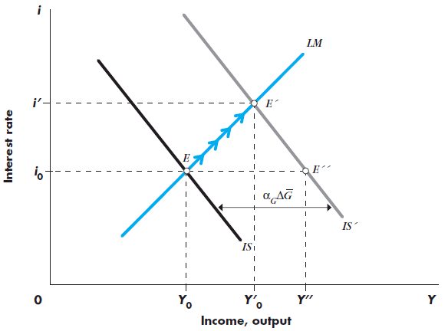
If government expenditures increase, equilibrium moves to from E to E”
The goods market is in equilibrium at E”, but the money market is not:
Because Y has increased, the demand for money also increases → interest rate increases
Firms’ planned investment spending declines and AD falls → move up the LM curve to E’

Slide 28
Fiscal Policy and Crowding Out
Comparing E to E’: increased government spending increases income and the interest rate
Comparing E’ to E”: adjustment of interest rates and their impact on AD dampen expansionary effect of increased G
Income increases to Y’₀ instead of Y”

Slide 29
The reason that income rises only to Yo’ rather than to Y’’ is that the rise in the interest rate from io to i’ reduces the level of investment spending.
We say that the increase in government spending crowds out investment spending.
Crowding out occurs when expansionary fiscal policy causes interest rates to rise, thereby reducing private spending, particularly investment.

Slide 30
What factors determine how much crowding out takes place?
In other words, what determines the extent to which interest rate adjustments dampen the output expansion induced by increased government spending? By drawing for yourself different IS and LM schedules, you will be able to show the following:
• Income increases more, and interest rates increase less, the flatter the LM schedule.
• Income increases less, and interest rates increase less, the flatter the IS schedule.
• Income and interest rates increase more the larger the multiplier and thus the larger the horizontal shift of the IS schedule.

Slide 31
In each case the extent of crowding out is greater the more the interest rate increases when government spending rises. To illustrate these conclusions, we turn to the two extreme cases we discussed in connection with monetary policy, the liquidity trap and the classical case.

Slide 32
THE LIQUIDITY TRAP
If the economy is in the liquidity trap, and thus the LM curve is horizontal, an increase in government spending has its full multiplier effect on the equilibrium level of income. There is no change in the interest rate associated with the change in government spending, and thus no investment spending is cut off. There is therefore no dampening of the effects of increased government spending on income.

Slide 33
If the LM curve is horizontal, monetary policy has no impact on the equilibrium of the economy and fiscal policy has a maximal effect.
Less dramatically, if the demand for money is very sensitive to the interest rate, and thus the LM curve is almost horizontal, fiscal policy changes have a relatively large effect on output and monetary policy changes have little effect on the equilibrium level of output.

Slide 34
THE CLASSICAL CASE AND CROWDING OUT
If the LM curve is vertical, an increase in government spending has no effect on the equilibrium level of income and increases only the interest rate.
Thus, with a vertical LM curve, an increase in government spending cannot change the equilibrium level of income and raises only the equilibrium interest rate.

Slide 35
But if government spending is higher and output is unchanged, there must be an offsetting reduction in private spending. In this case, the increase in interest rates crowds out an amount of private (particularly investment) spending equal to the increase in government spending. Thus, there is full crowding out if the LM curve is vertical.

Slide 36
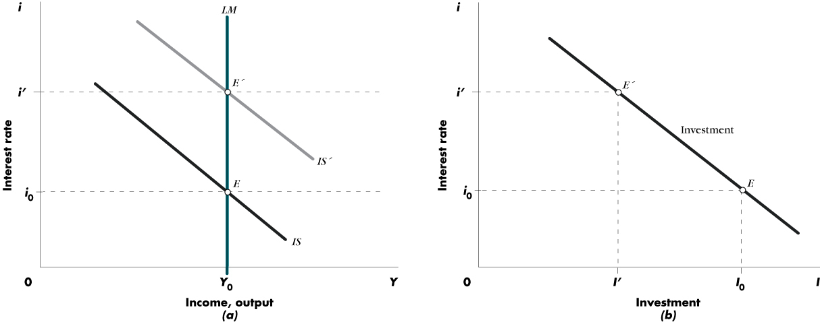
Full Crowding Out

Slide 37
MONETARY ACCOMMODATION OF FISCAL EXPANSION
Monetary policy is accommodating when, in the course of a fiscal expansion, the money supply is increased in order to prevent interest rates from increasing.
Monetary accommodation is also referred to as monetizing budget deficits, meaning that the CB prints money to buy the bonds with which the government pays for its deficit.

Slide 38
When the CB accommodates a fiscal expansion, both the IS and the LM schedules shift to the right.
Output will clearly increase, but interest rates need not rise. Accordingly, there need not be any adverse effects on investment.

Slide 39
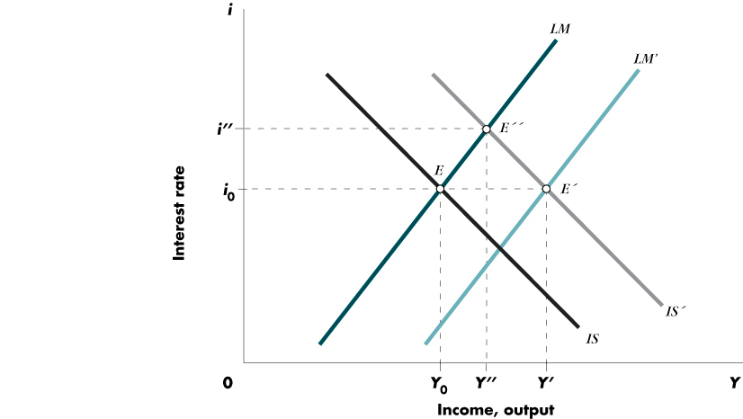
MONETARY ACCOMMODATION OF FISCAL EXPANSION

Slide 40
The Composition of Output and the Policy Mix
Table 12-2 summarizes effects of expansionary monetary and fiscal policy on output and the interest rate
Monetary policy operates by stimulating interest-responsive components of AD
Fiscal policy operates through G and t → impact depends upon what goods the government buys and what taxes and transfers it changes

Slide 41
The choice between monetary and fiscal policies as tools of stabilization policy is an important and controversial topic.
One basis for decision is the flexibility and speed with which these policies can be implemented and take effect.
Here we do not discuss speed and flexibility; rather, we look at what those policies do to the components of aggregate demand, that is, to investment, consumption, and government spending, respectively.

Slide 42
In that respect, there is a sharp difference between monetary policy and fiscal policy. Monetary policy operates by stimulating interest–responsive components of aggregate demand, primarily investment spending. There is strong evidence that the earliest effect of monetary policy is on residential construction.

Slide 43
Fiscal policy, by contrast, operates in a manner that depends on precisely what goods the government buys or what taxes and transfers it changes.
Choices include government purchases of goods and services such as defense spending or a reduction in the corporate profits tax, sales taxes, or social security contributions.
Each policy affects the level of aggregate demand and causes an expansion in output, but the composition of the increase in output depends on the specific policy.

Slide 44
An increase in government spending raises consumption spending along with government purchases. An income tax cut has a direct effect on consumption spending.
An investment subsidy, discussed below, increases investment spending. All expansionary fiscal policies will raise the interest rate if the quantity of money is unchanged.

Slide 45
AN INVESTMENT SUBSIDY
Both an income tax cut and an increase in government spending raise the interest rate and reduce investment spending.
However, it is possible for the government to raise investment spending through an investment subsidy.
When the government subsidizes investment, it essentially pays part of the cost of each firm’s investment.
An investment subsidy shifts the investment schedule to the right. At each interest rate, firms now plan to invest more. With investment spending higher, aggregate demand increases.

Slide 46
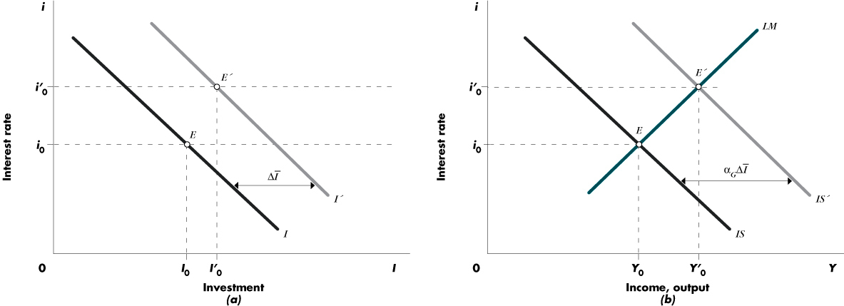

Slide 47
In panel (b), the IS schedule shifts by the amount of the multiplier times the increase in autonomous investment brought about by the subsidy. The new equilibrium is at point E’, where goods and money markets are again in balance.
But note now that although interest rates have risen, we see, in panel (a), that investment is higher. Investment is at the level up I0’ from I0.
The interest rate increase dampens but does not reverse the impact of the investment subsidy. This is an example in which both consumption, induced by higher income, and investment rise as a consequence of expansionary fiscal policy.

Slide 48
Alternative Fiscal Policies
 | Interest Rate | Consumption | Investment | GDP
Income Tax Cut | + | + | - | +
Government Spending | + | + | - | +
Investment Subsidy | + | + | + | +

Slide 49
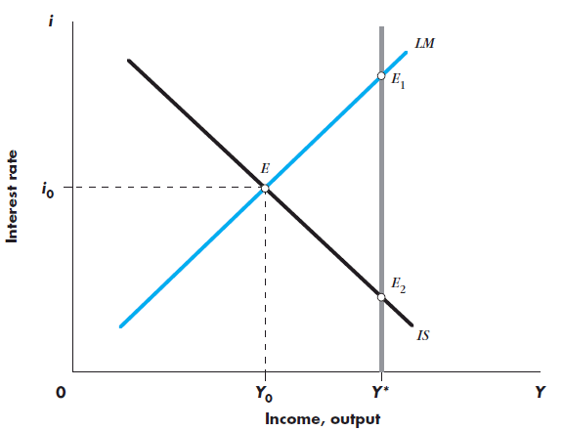
The Composition of Output and the Policy Mix
Policy problem of reaching full employment output, Y*, for an economy that is initially at point E, with unemployment
Choices:
Fiscal policy expansion, moving to point E₁, with higher income and higher interest rates
Monetary policy expansion, resulting in full employment with lower interest rates at point E₂
A mix of fiscal expansion and accommodating monetary policy resulting in an intermediate position

Slide 50
The Composition of Output and the Policy Mix
Policies all increase output, but significantly different impact on sectors of the economy → problem of political economy
Who should be the primary beneficiary of expansion?
An expansion through a decline in interest rates and increased investment spending?
An expansion through a tax cut and increased personal consumption?
An expansion in the form of an increase in the size of the government?

Slide 51
SUMMARY
1. Monetary policy affects the economy, first, by affecting the interest rate and then by affecting aggregate demand. An increase in the money supply reduces the interest rate, increases investment spending and aggregate demand, and thus increases equilibrium output.

Slide 52
2. There are two extreme cases in the operation of monetary policy. In the classical case the demand for real balances is independent of the rate of interest. In that case monetary policy is highly effective. The other extreme is the liquidity trap, the case in which the public is willing to hold any amount of real balances at the going interest rate. In that case changes in the supply of real balances have no impact on interest rates and therefore do not affect aggregate demand and output.

Slide 53
3. Fiscal expansion, except in extreme circumstances, still leads to an income expansion. However, the rise in interest rates that comes about through the increase in money demand caused by higher income dampens the expansion.
4. Fiscal policy is more effective the smaller the induced changes in interest rates and the smaller the response of investment to these interest rate changes.

Slide 54
5. The two extreme cases, the liquidity trap and the classical case, are useful to show what determines the magnitude of monetary and fiscal policy multipliers. In the liquidity trap, monetary policy has no effect on the economy, whereas fiscal policy has its full multiplier effect on output and no effect on interest rates. In the classical case, changes in the money stock change income, but fiscal policy has no effect on income—it affects only the interest rate. In this case, there is complete crowding out of private spending by government spending.

Slide 55
6. A fiscal expansion, because it leads to higher interest rates, displaces, or crowds out, some private investment. The extent of crowding out is a sensitive issue in assessing the usefulness and desirability of fiscal policy as a tool of stabilization policy.

Slide 56
7. The question of the monetary-fiscal policy mix arises because expansionary monetary policy reduces the interest rate while expansionary fiscal policy increases the interest rate. Accordingly, expansionary fiscal policy increases output while reducing the level of investment; expansionary monetary policy increases output and the level of investment.

Slide 57
8. Governments have to choose the mix in accordance with their objectives for economic growth, or increasing consumption, or from the viewpoint of their beliefs about the desirable size of the government.

